Slide 1
Amazon India Analytics Dashboard
Business Insights | Data Engineering | Visualization

Slide 2
Project Objective
Analyze Amazon India sales data (2015–2025)
Identify revenue, customer, and product trends
Build interactive dashboard using Streamlit
Enable data-driven business decisions
Use SQL and Python for data processing

Slide 3
Data Engineering Pipeline
Raw CSV data ingestion
Data cleaning using Python (Pandas)
Data transformation and validation
Loading into PostgreSQL database

Slide 4
Data Cleaning Highlights
Currency cleaned (₹, commas removed)
Mixed date formats standardized
Boolean columns normalized
Missing values handled
Duplicates removed

Slide 5
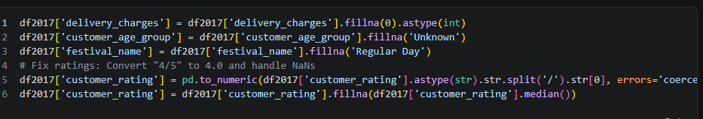
Data Cleaning Highlights

Slide 6
Database Architecture
transactions (fact table)
maintable(merge all the data in one table)
customers (dimension)
products (dimension)
time_dimension (date analytics)
Optimized with indexing

Slide 7
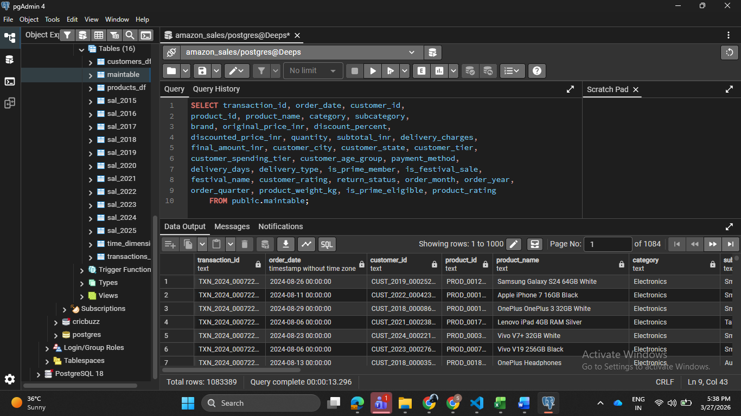
Main table

Slide 8
Executive Dashboards
Year-over-year growth analysis
Active Customers & Customer Acquisition Trends
Trend line using regression
Average Order Value(AOV) tracking
Peak growth identification
Revenue forecasting patterns

Slide 9
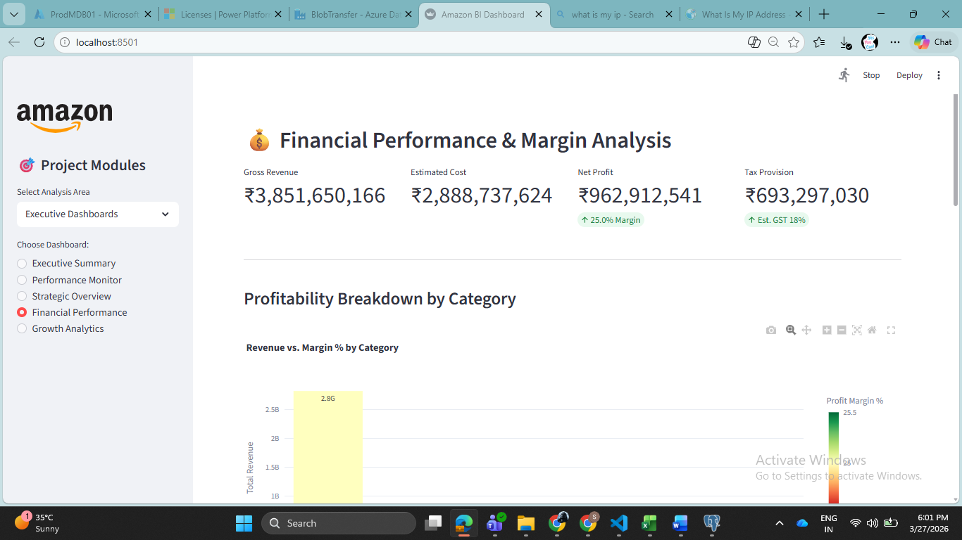
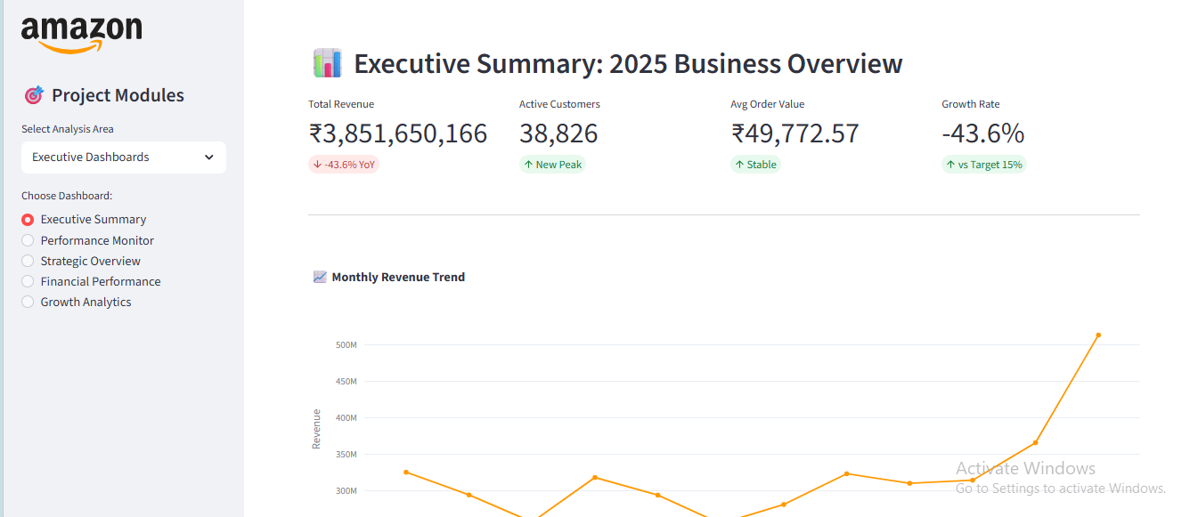
Executive dashboard Insights

Slide 10
Revenue & Customer Analytics
Time-Series Analysis: Visualizes historical revenue patterns to identify cyclical growth.
Interactive Selection: Users can toggle between time grains (e.g., viewing a 3-year trend vs. a 6-month deep dive).
Growth Rate Tracking: Calculates Month-on-Month (MoM) and Year-on-Year (YoY) percentages to flag decelerating or accelerating segments.

Slide 11
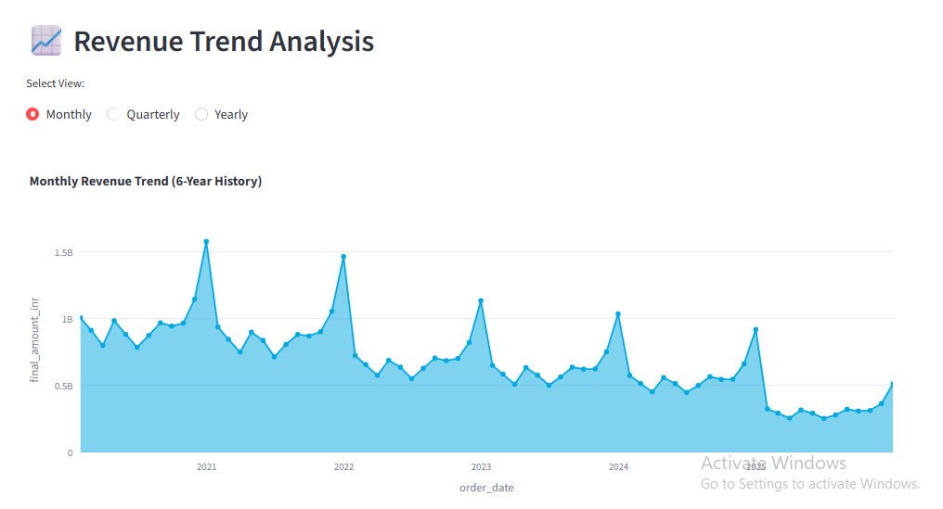
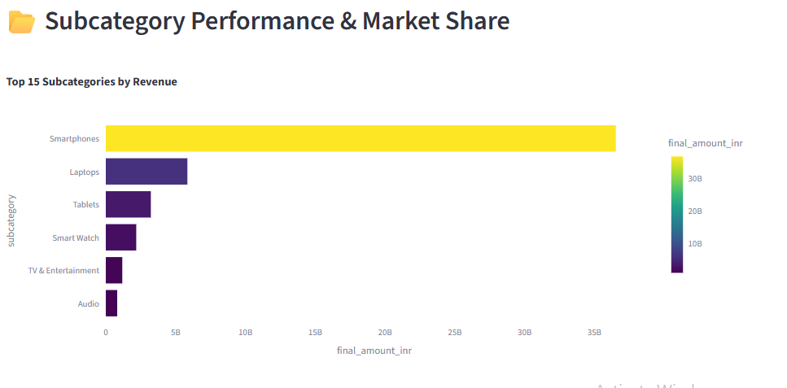
Revenue & Customer Analytics

Slide 12
Customer Segmentation (RFM)
Recency: Last purchase behavior
Frequency: Purchase count
Monetary: Total spending
Segments: Loyal, At Risk, High Value

Slide 13
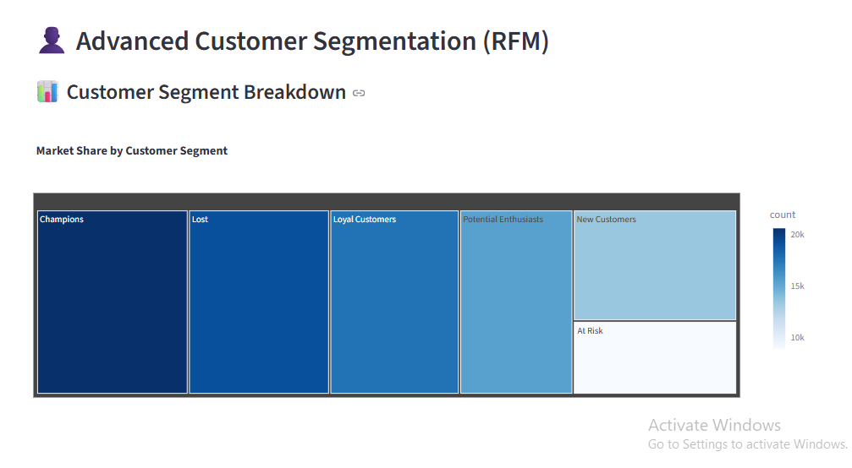
RFM Segmentation & Behavioral Profiles

Slide 14
Customer Journey & Evolution
Analyzes customer movement across product categories
Analyzes customer movement across product categories
Measures conversion from first-time buyers to repeat customers
Identifies drop-off points in customer lifecycle
Drives long-term customer lifetime value (CLV) growth

Slide 15
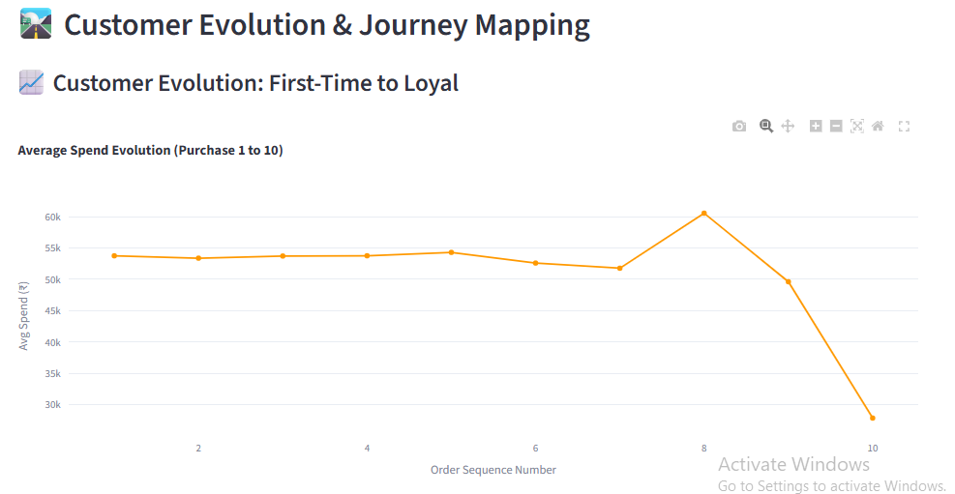
Customer Journey & Evolution

Slide 16
Prime Membership Analytics
Compares Prime vs Non-Prime customer behavior
Analyzes Average Order Value (AOV) differences
Evaluates purchase frequency and engagement levels
Identifies high-value customer segments
Tracks retention rate of Prime vs standard users
Measures customer lifetime and repeat purchases
Demonstrates Prime as a strong “loyalty driver”

Slide 17
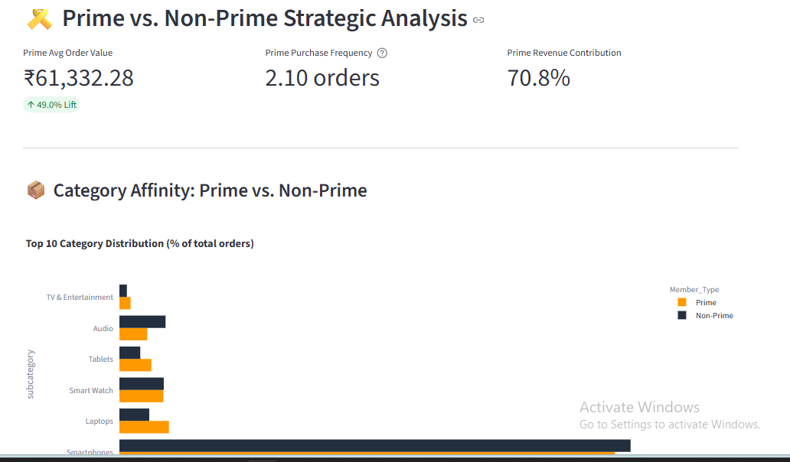
Prime Membership Analytics

Slide 18
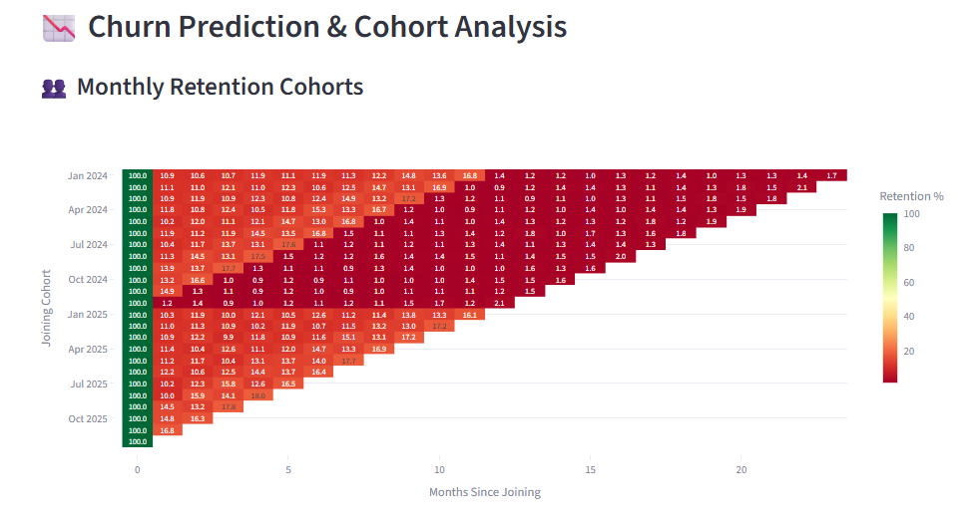
Retention, Cohorts & Churn

Slide 19
Demographics & Spending Patterns
Segments customers by age groups and spending tiers
Identifies high-value and profitable customer segments
Helps understand purchasing power and behavior patterns
Analyzes regional buying preferences across cities
Example: High-end electronics demand vs traditional product trends
Supports region-specific product and inventory planning

Slide 20
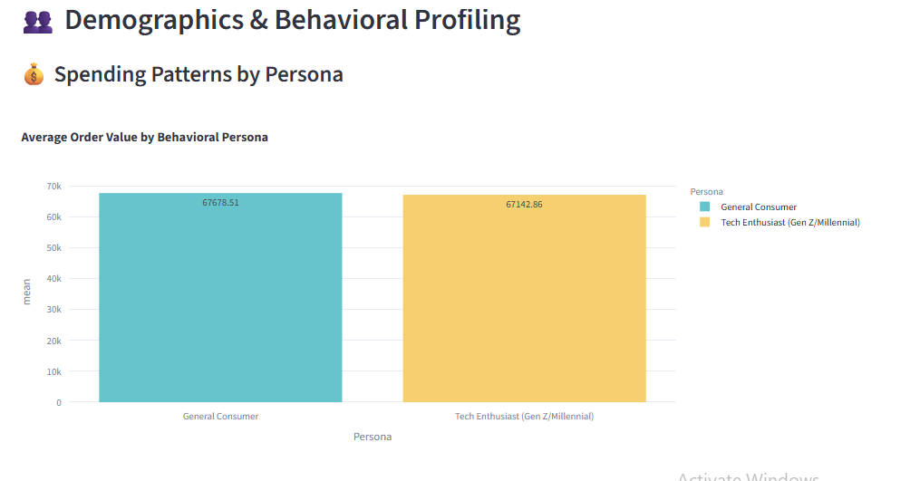
Demographics & Spending Patterns

Slide 21
Product & Inventory Analytics
Identifies top-performing vs underperforming products
Tracks product lifecycle from launch to maturity
Supports decisions on scaling or liquidation
Measures inventory turnover for efficiency
Differentiates fast-moving vs slow-moving products
Measures inventory turnover for efficiency
Differentiates fast-moving vs slow-moving products

Slide 22
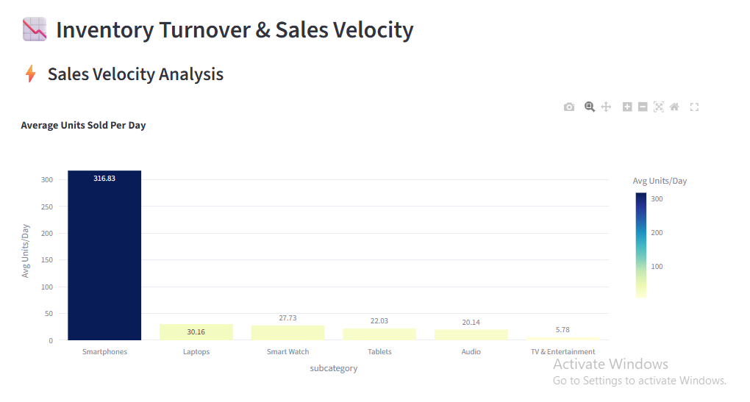
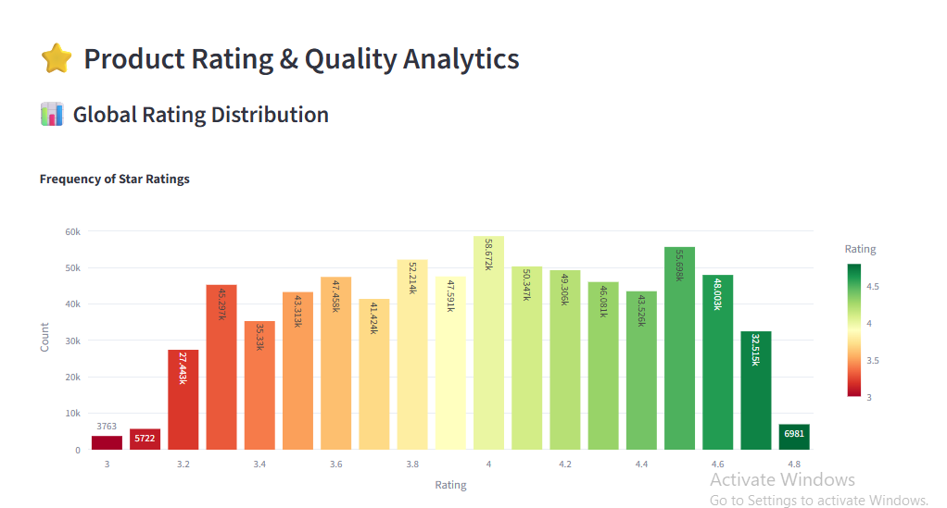
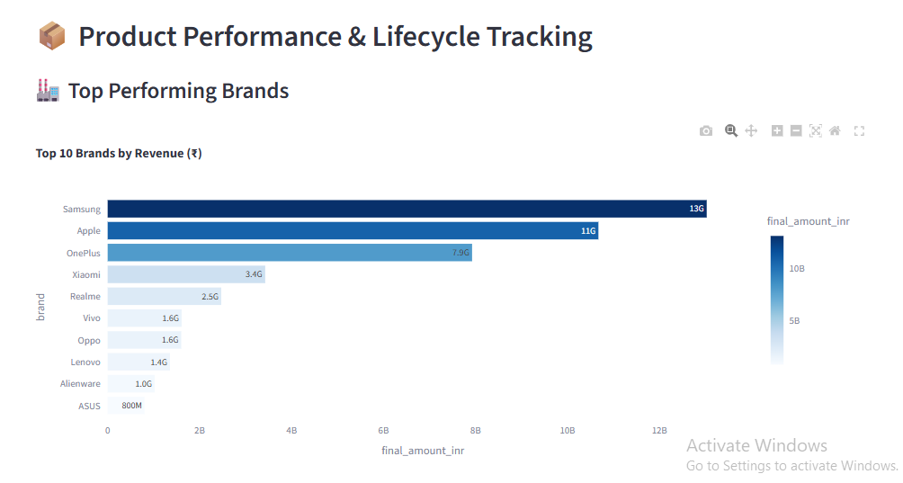
Product & Inventory Analytics

Slide 23

Operations & Logistics Overview
Tracks end-to-end order flow (Pick, Pack, Ship → Delivery)
Monitors warehouse capacity and order cycle time
Ensures faster delivery and operational efficiency
Measures CSAT, delivery speed, and resolution time
Tracks On-Time Delivery (OTD) across regions
Identifies delays and improves last-mile delivery experience

Slide 24
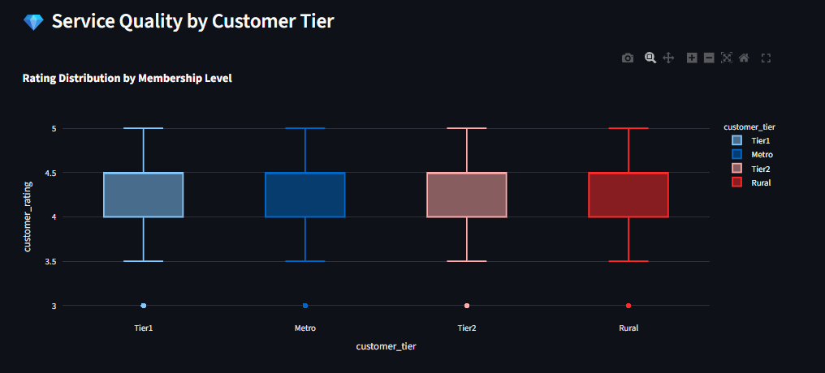
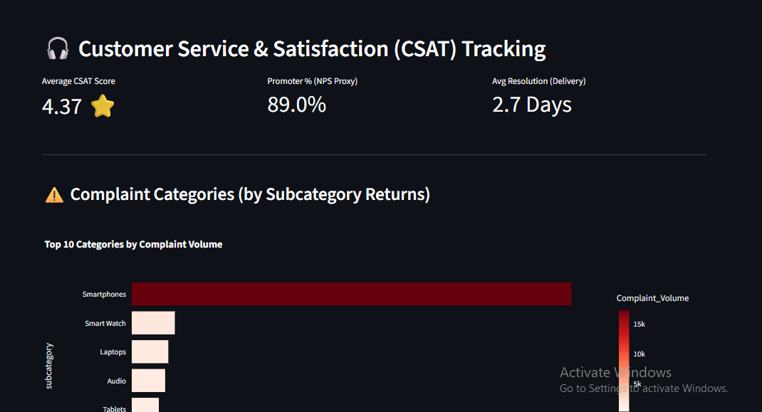
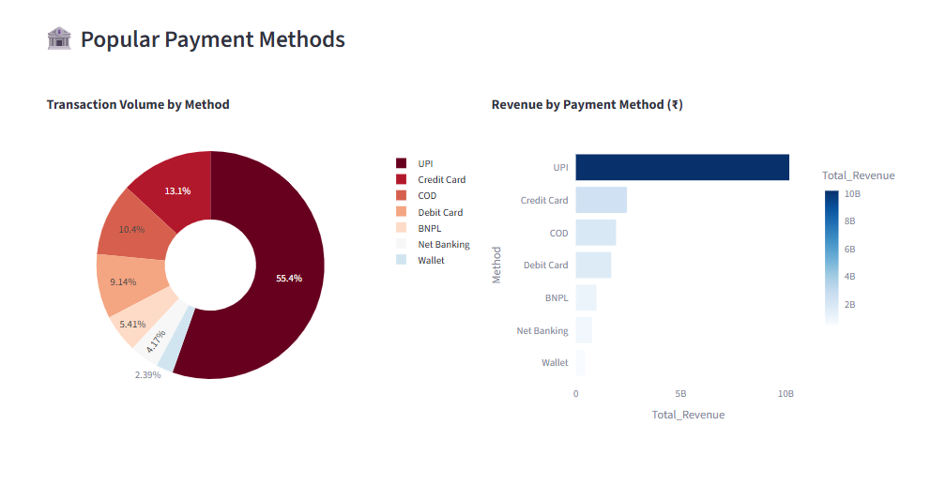
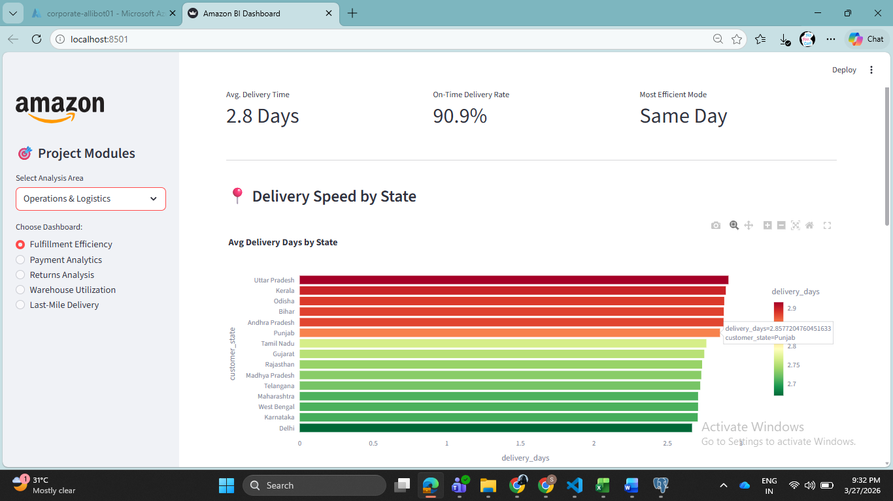
Operations & Logistics Overview

Slide 25
Advanced Analytics Overview
🔮 Predictive Analytics & Forecasting
Uses time-series models to predict sales and growth trends
Forecasts revenue, demand, and market fluctuations
Supports data-driven planning and target setting
🧠 Customer Intelligence & Personalization
Predicts customer churn using behavioral patterns
Recommends products for cross-selling & upselling
Enhances customer lifetime value (LTV) and engagement

Slide 26
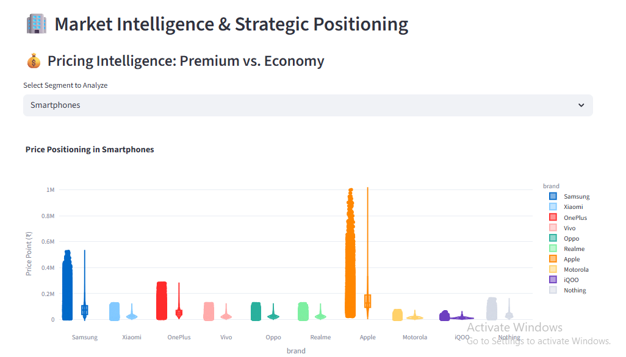
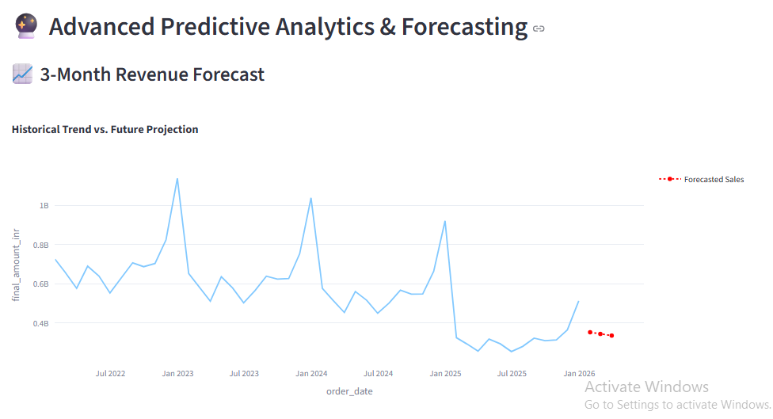
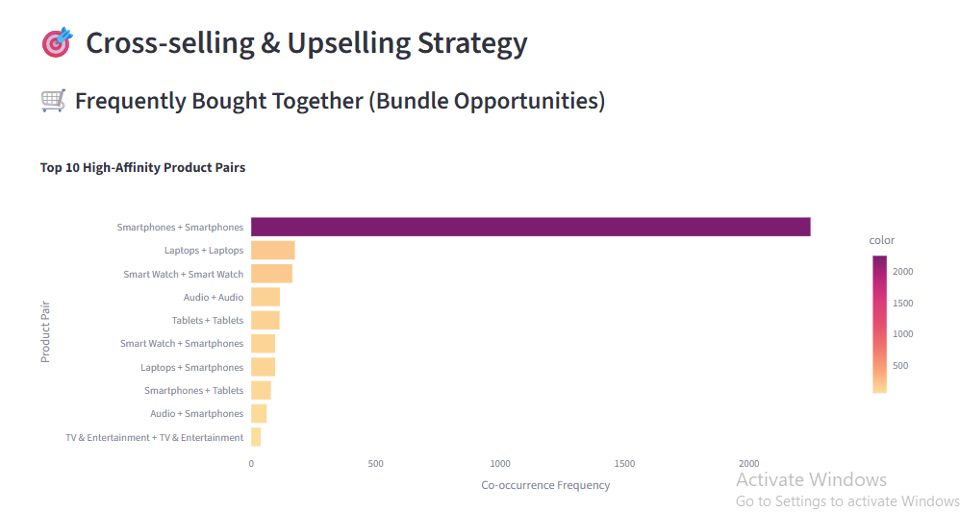
Advanced Analytics Overview

Slide 27
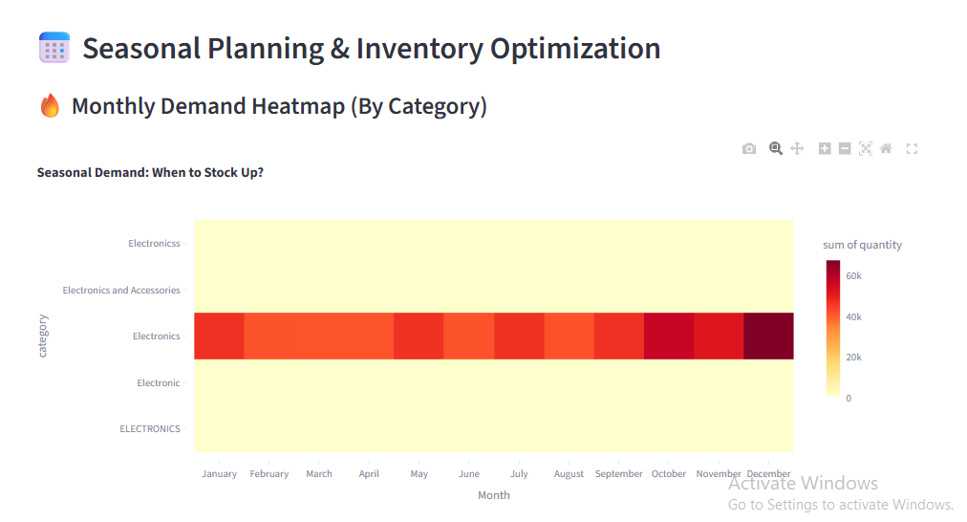
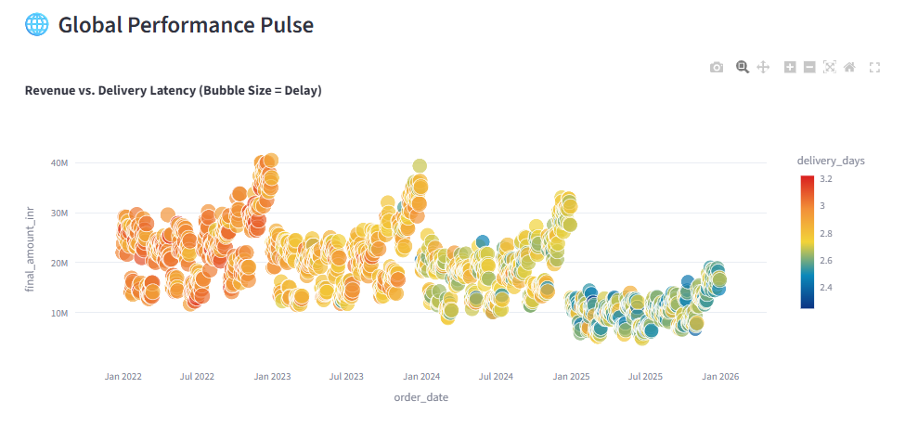
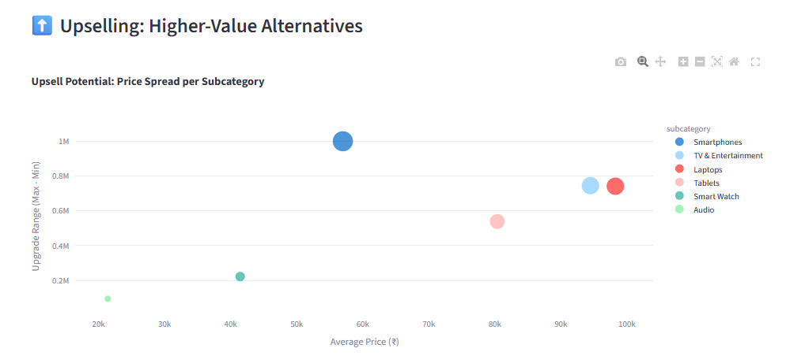
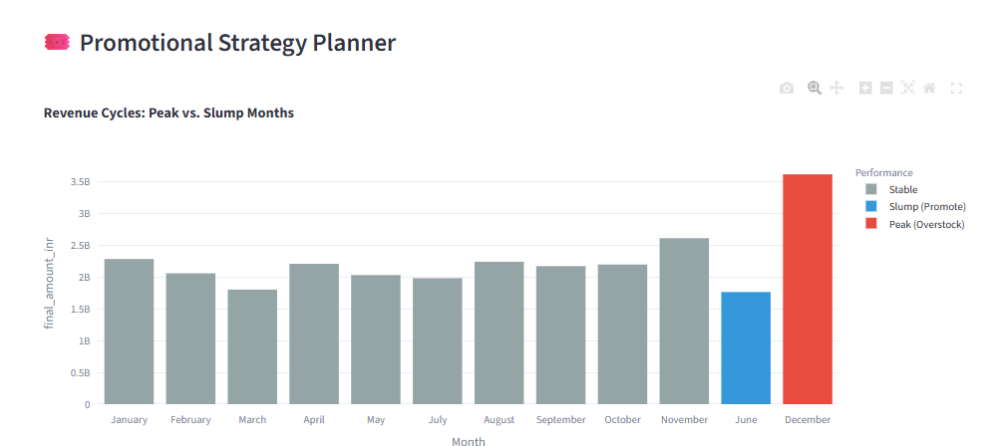

Slide 28
Dashboard Features
Interactive Streamlit UI
Sidebar navigation modules
Dynamic filtering
Real-time analytics visualization

Slide 29
Business Impact
Improved decision-making
Identified growth opportunities
Enhanced customer targeting
Operational optimization

Slide 30
Conclusion
End-to-end data analytics solution
Scalable architecture
Actionable business insights
Future scope: AI & forecasting

